Slide 1
13
Water Resources

Slide 2
Case Study: The Colorado River Story
The Colorado River
  Flows 2,300 km through seven U.S. states
  Includes 14 dams and reservoirs
  Water supplied mostly from snowmelt of the Rocky Mountains
  Supplies water and electricity for about 30 million people
    Las Vegas, Los Angeles, San Diego
  Responsible for irrigation of crops that help feed America

Slide 3
Case Study: The Colorado River Story (cont’d.)
Issues
  Very little water is reaching the Gulf of California
  The southwest has recently been recent droughts

Slide 4
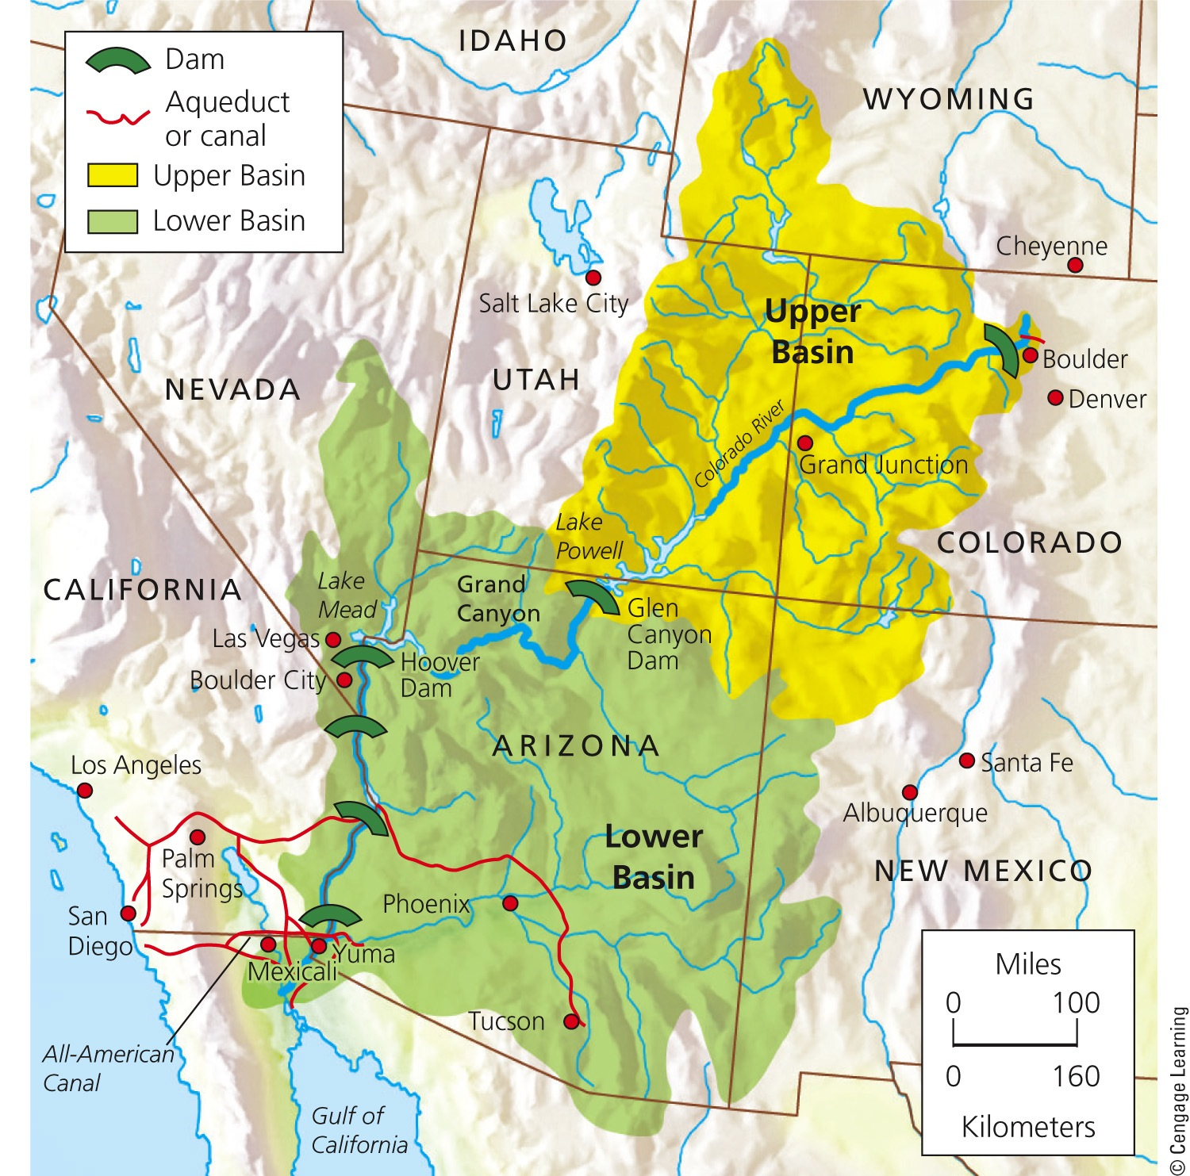
The Colorado River Basin
Fig. 13-1, p. 318
Notes:
Figure 13-1: The Colorado River basin: The area drained by this river system is more than one-twelfth of the land area of the lower 48 states. This map shows 6 of the river’s 14 dams.

Slide 5
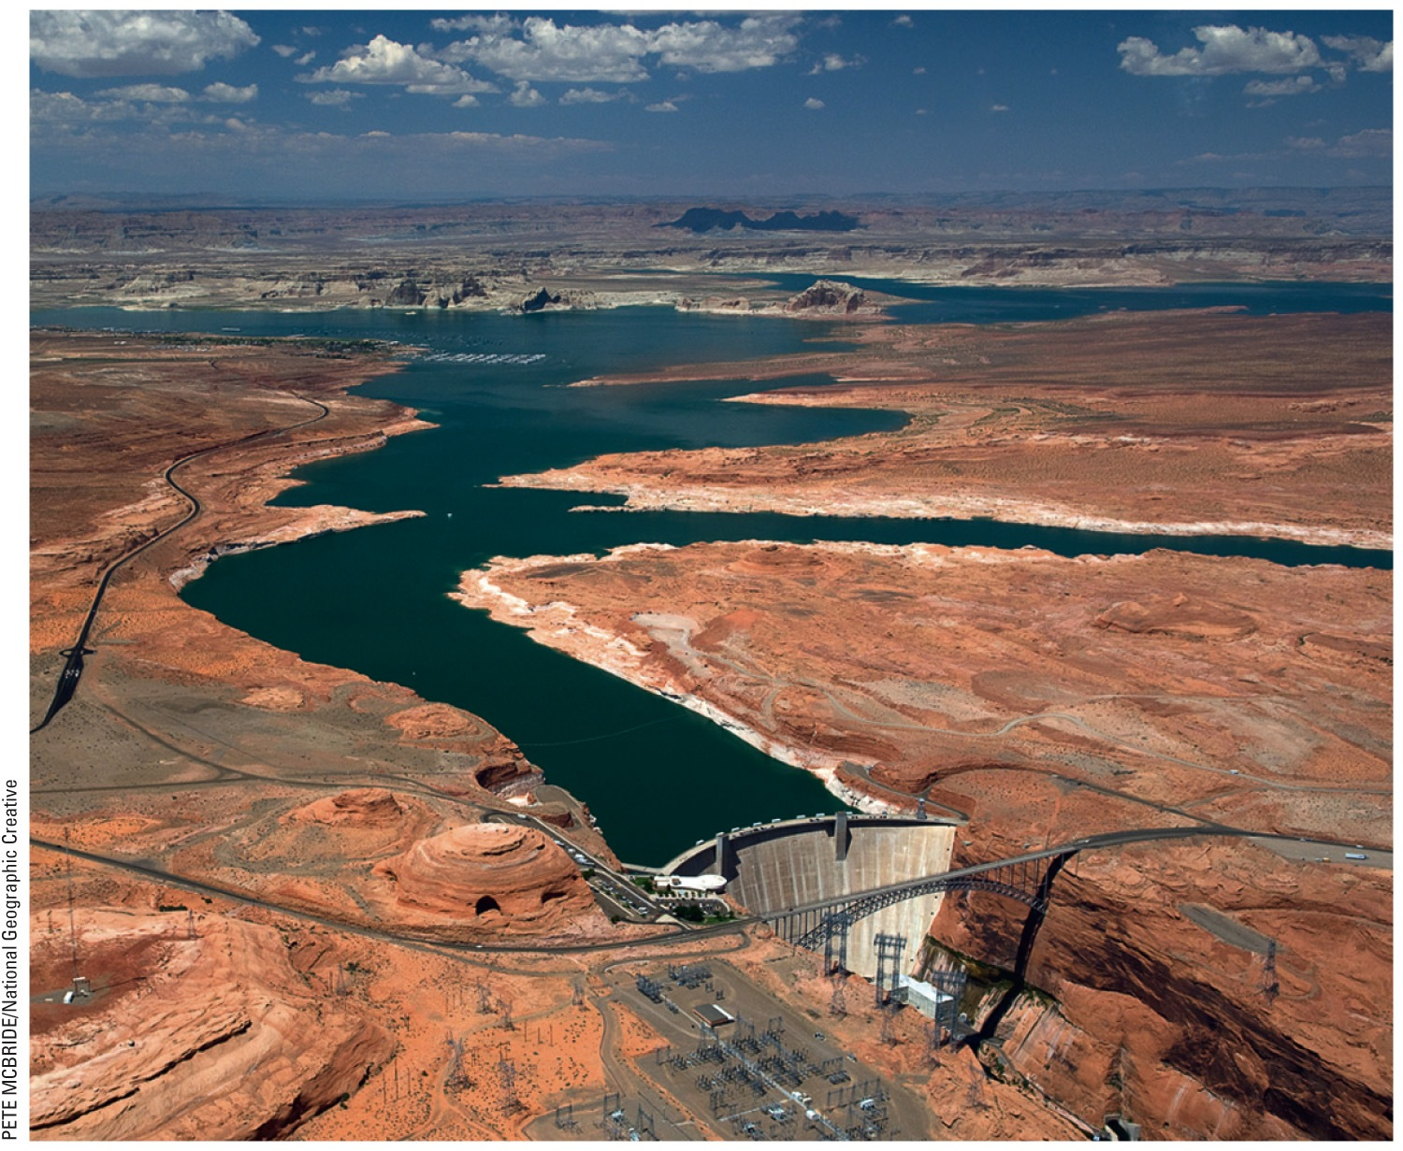
Fig. 13-2, p. 318
Notes:
Figure 13-2: The Glen Canyon Dam was built to create the Lake Powell reservoir on the Colorado River.

Slide 6
13-1 Will We Have Enough Usable Water?
We are using available freshwater unsustainably by wasting it, polluting it, and underpricing what is an irreplaceable natural resource
Freshwater supplies are not evenly distributed, and one of every six people on the planet does not have adequate access to clean water

Slide 7
Freshwater Is an Irreplaceable Resource That We Are Managing Poorly
Water covers 71% of the earth’s surface
Poorly managed resource
  Global health issue
  Economic issue
  National and global security issue
  Environmental issue

Slide 8
Most of the Earth’s Freshwater Is Not Available to Us
Freshwater availability – 0.024%
  Groundwater, lakes, rivers, and streams
Hydrologic cycle
  Movement of water in the seas, land, and air
  Driven by solar energy and gravity
  Distributed unevenly
Humans can alter the hydrologic cycle
  Withdrawing water, polluting, climate change

Slide 9
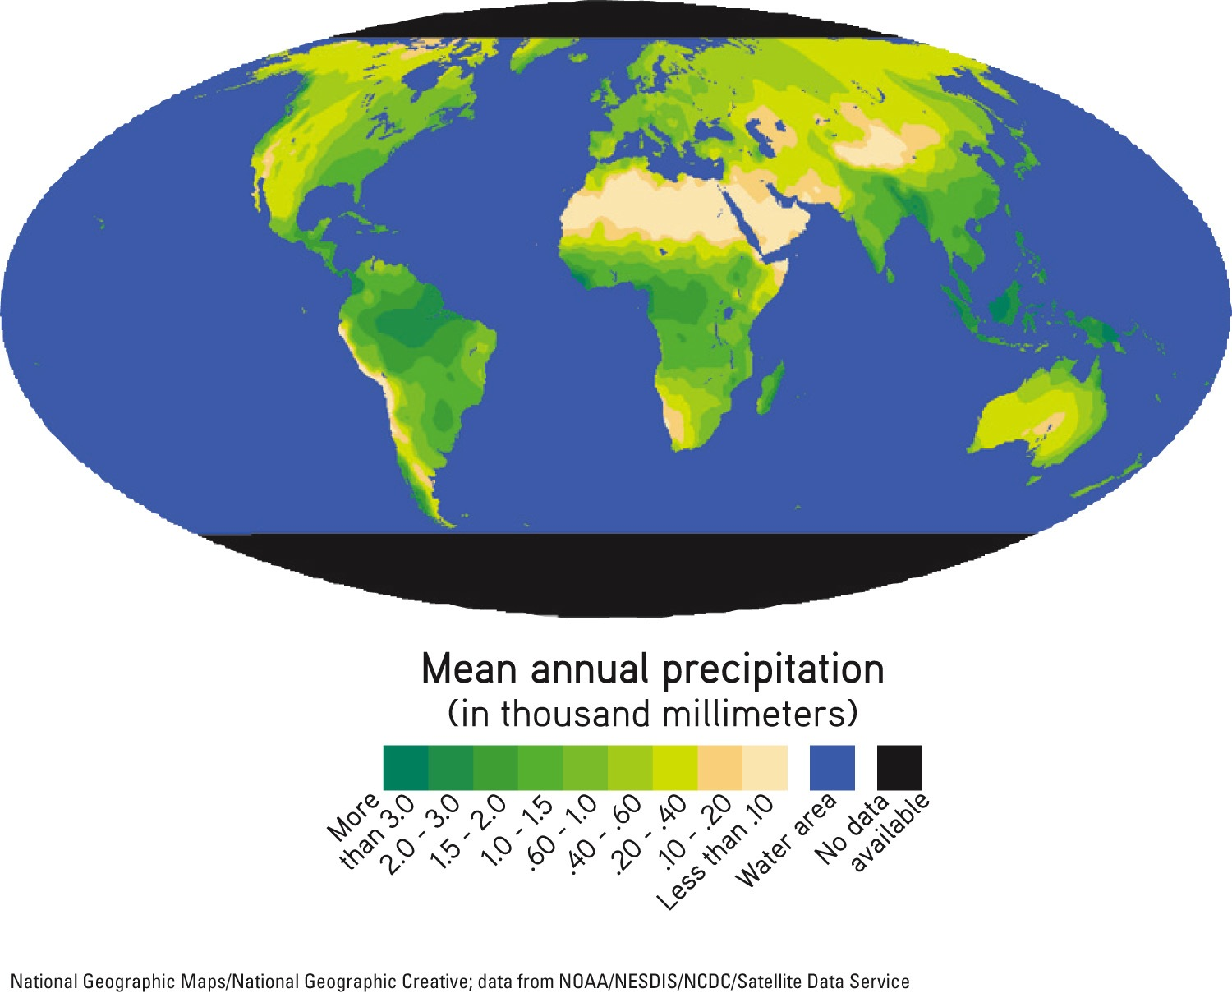
Fig. 13-4, p. 320
Notes:
Figure 13-4: Global average annual precipitation.

Slide 10
Groundwater and Surface Water Are Critical Resources
Zone of saturation
  Spaces in soil are filled with water
Water table
  Top of zone of saturation
Aquifers
  Natural recharge
  Lateral recharge

Slide 11
Groundwater and Surface Water Are Critical Resources (cont’d.)
Surface water
  Surface runoff
  Watershed (drainage) basin

Slide 12
We Are Using Increasing Amounts of the World’s Reliable Runoff
2/3 of the surface runoff – lost by seasonal floods
Reliable runoff
  Remaining 1/3 on which we can rely
Worldwide averages
  Domestic: 10%
  Agriculture: 70%
  Industrial use: 20%

Slide 13
We Are Using Increasing Amounts of the World’s Reliable Runoff (cont’d.)
Agriculture counts for 92% of humanity’s water footprint
Virtual water
  Not consumed; used to produce food and other products

Slide 14
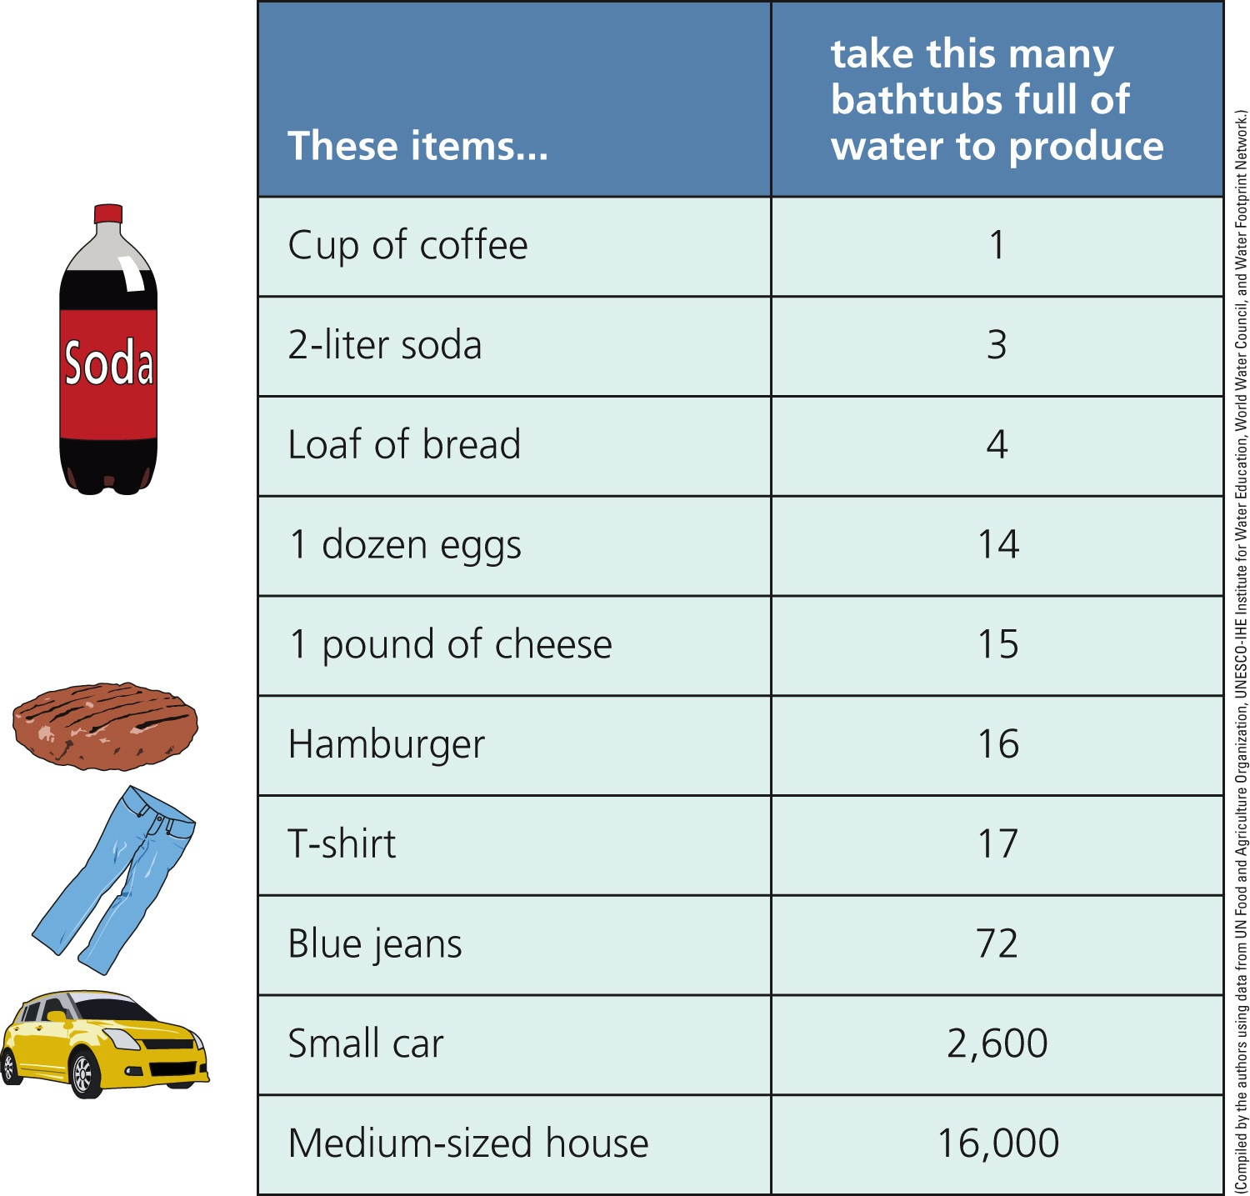
Fig. 13-6, p. 322
Notes:
Figure 13-6: Producing and delivering a single one of each of the products shown here requires the equivalent of at least one and usually many bathtubs full of freshwater, called virtual water. Note: 1 bathtub 5 151 liters (40 gallons).

Slide 15
Case Study: Freshwater Resources in the United States
More than enough renewable freshwater, unevenly distributed and polluted
What are the effects of the following?
  Floods
  Pollution
  Drought
U.S. Geological Survey projection, 2007
  Water hotspots

Slide 16
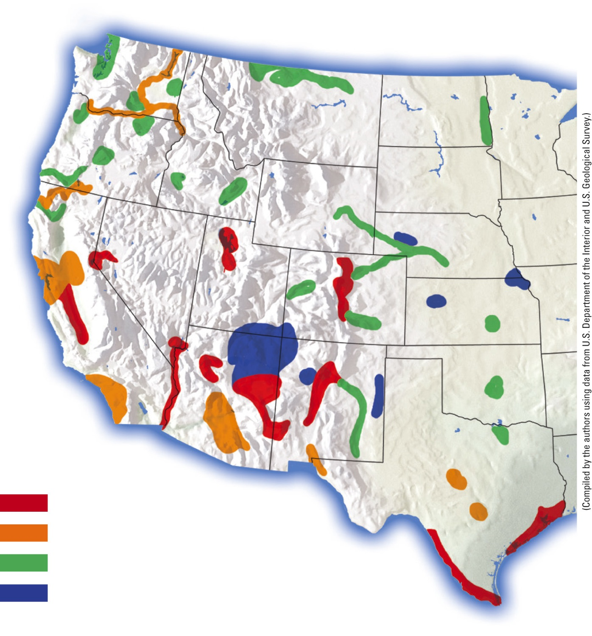
Washington
North Dakota
Montana
Oregon
Idaho
South Dakota
Wyoming
Nevada
Nebraska
Utah
Colorado
Kansas
California
Oklahoma
New Mexico
Arizona
Texas
Highly likely conflict potential
Substantial conflict potential
Moderate conflict potential
Unmet rural water needs
Fig. 13-8, p. 323
Notes:
Figure 13-8: This map shows water scarcity hotspots in 17 western states that, by 2025, could face intense conflicts over scarce water needed for urban growth, irrigation, recreation, and wildlife. Question: Which, if any, of these areas are found in the Colorado River basin (Core Case Study)?

Slide 17
Freshwater Shortages Will Grow
Main factors that cause scarcity:
  Dry climates
  Drought
  Too many people using a normal supply of water
  Wasteful use of water
U.N. 2010 study
  By 2025, three billion people will likely lack access to clean water

Slide 18
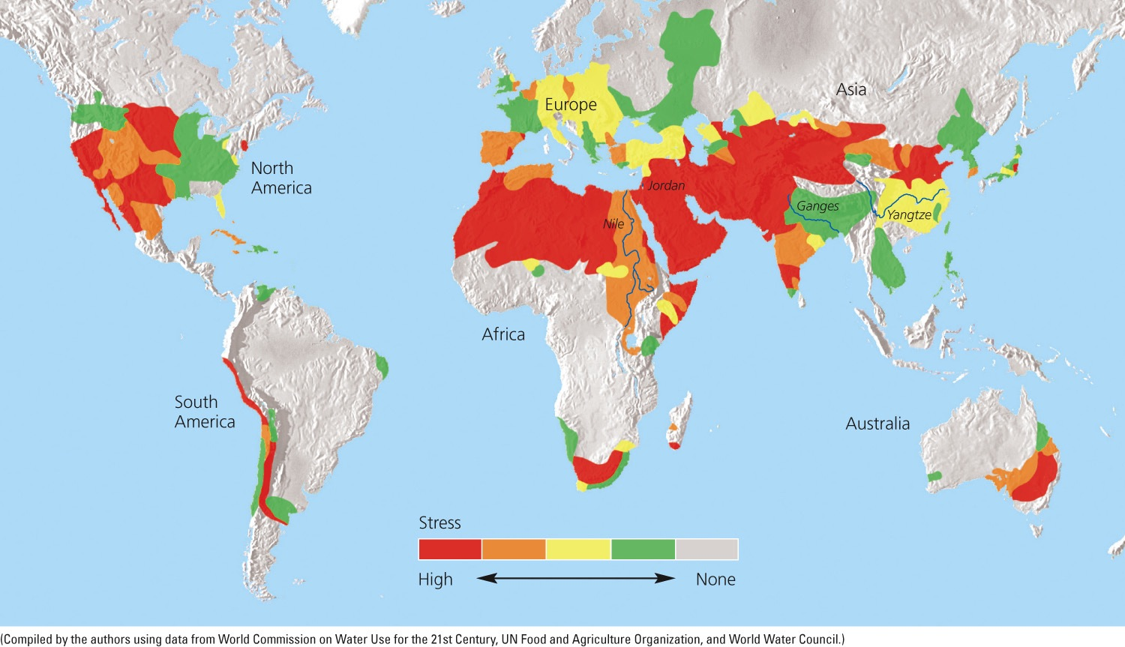
Fig. 13-9, p. 324
Notes:
Figure 13-9: Natural capital degradation. The world’s major river basins differ in their degree of freshwater scarcity stress (Concept 13-1B). Questions: If you live in a freshwater-stressed area, what signs of stress have you noticed? In what ways, if any, has it affected your life?

Slide 19
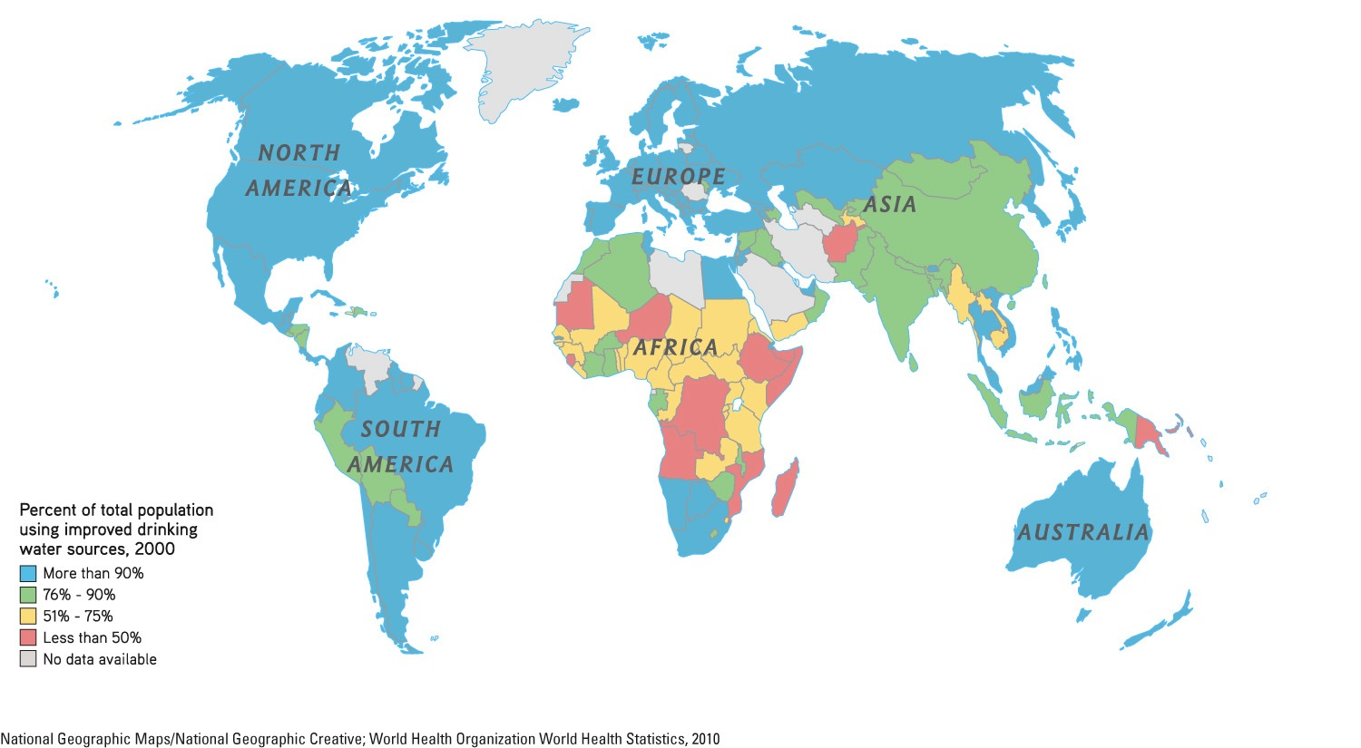
Fig. 13-10, p. 324
Notes:
Figure 13-10: Access to freshwater.

Slide 20
There Are Ways to Increase Freshwater Supplies
Accurate information about water shortages
Approaches:
  Withdrawing groundwater
  Building dams and reservoirs
  Transporting surface water
  Converting saltwater to freshwater

Slide 21
13-2 Is Groundwater a Sustainable Resource?
Groundwater used to supply cities and grow food is being pumped from aquifers in some areas faster than it is renewed by precipitation

Slide 22
Groundwater is Being Withdrawn Faster Than It Is Replenished in Some Areas
Most aquifers are renewable
  Unless water is contaminated or removed
Aquifers provide drinking water for half the world
Water tables are falling in many parts of the world, primarily from crop irrigation

Slide 23
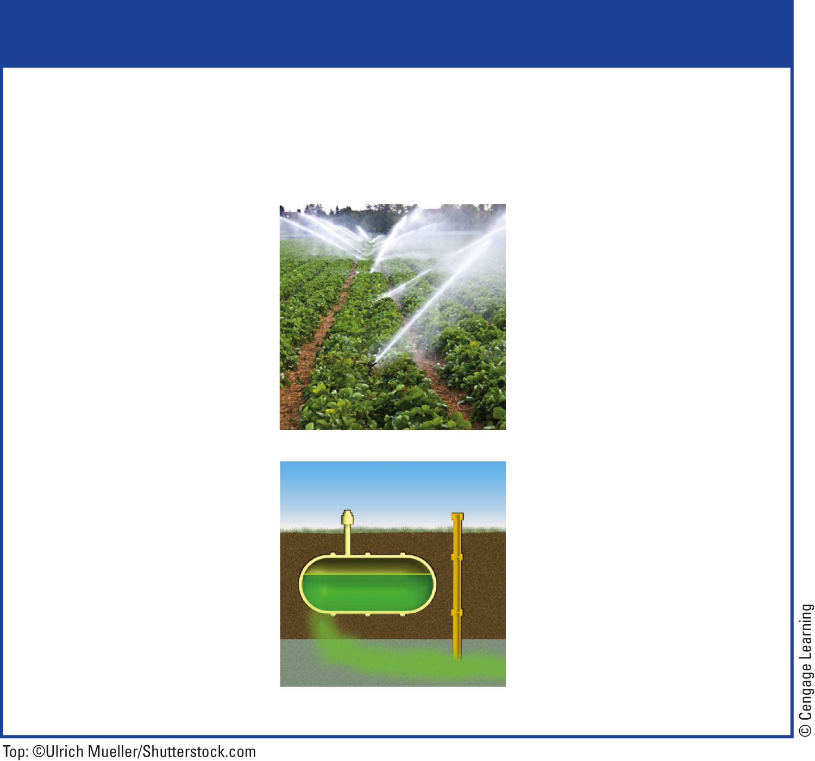
Trade-Offs
Withdrawing Groundwater
Advantages
Disadvantages
Useful for drinking and irrigation
Aquifer depletion from overpumping
Exists almost everywhere
Sinking of land (subsidence) from overpumping
Renewable if not overpumped or contaminated
Some deeper wells are nonrenewable
Cheaper to extract than most surface waters
Pollution of aquifers lasts decades or centuries
Fig. 13-11, p. 326
Notes:
Figure 13-11: Withdrawing groundwater from aquifers has advantages and disadvantages. Questions: Which two advantages and which two disadvantages do you think are the most important? Why?

Slide 24
Case Study: Overpumping the Ogallala
Ogallala aquifer – largest known aquifer
  Irrigates the Great Plains
  Very slow recharge
  Water table dropping
    Water pumped 10-40 times faster than recharge
  Government subsidies to continue farming deplete the aquifer further
  Biodiversity threatened in some areas

Slide 25
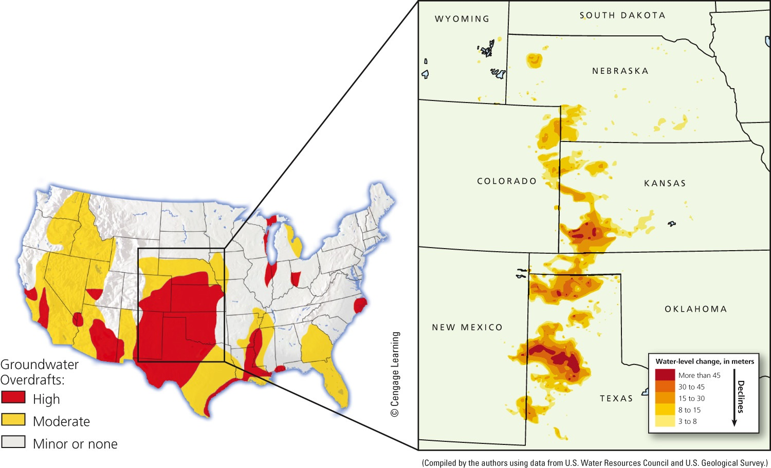
Fig. 13-13, p. 328
Notes:
Figure 13-13: Natural capital degradation: This map shows areas of greatest aquifer depletion from groundwater overdraft in the continental United States. The blowup section (right) shows where water levels in the Ogallala aquifer have dropped sharply at its southern end beneath parts of Kansas, Oklahoma, Texas, and New Mexico. Questions: Do you depend on any of these aquifers for your drinking water? If so, what is the level of severity of overdraft where you live?

Slide 26
Overpumping Aquifers Has Several Harmful Effects
Limits future food production
Bigger gap between the rich and the poor
Land subsidence
  Mexico City
  San Joaquin Valley in California
Groundwater overdrafts near coastal regions
  Contamination of groundwater with saltwater

Slide 27
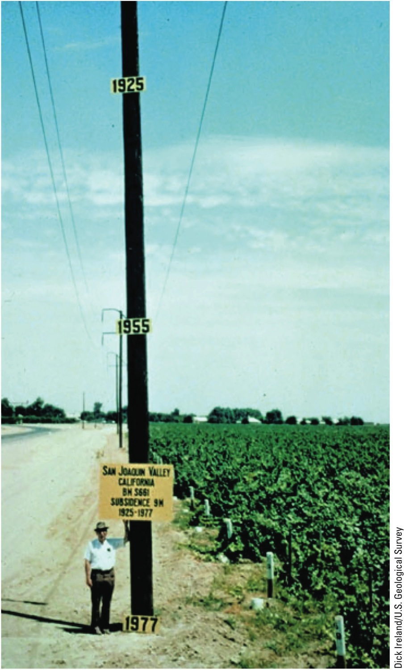
Fig. 13-15, p. 329
Notes:
Figure 13-15: This pole shows subsidence from overpumping of an aquifer for irrigation in California’s San Joaquin Central Valley between 1925 and 1977. In 1925, the land surface in this area was near the top of this pole. Since 1977 this problem has gotten worse.

Slide 28
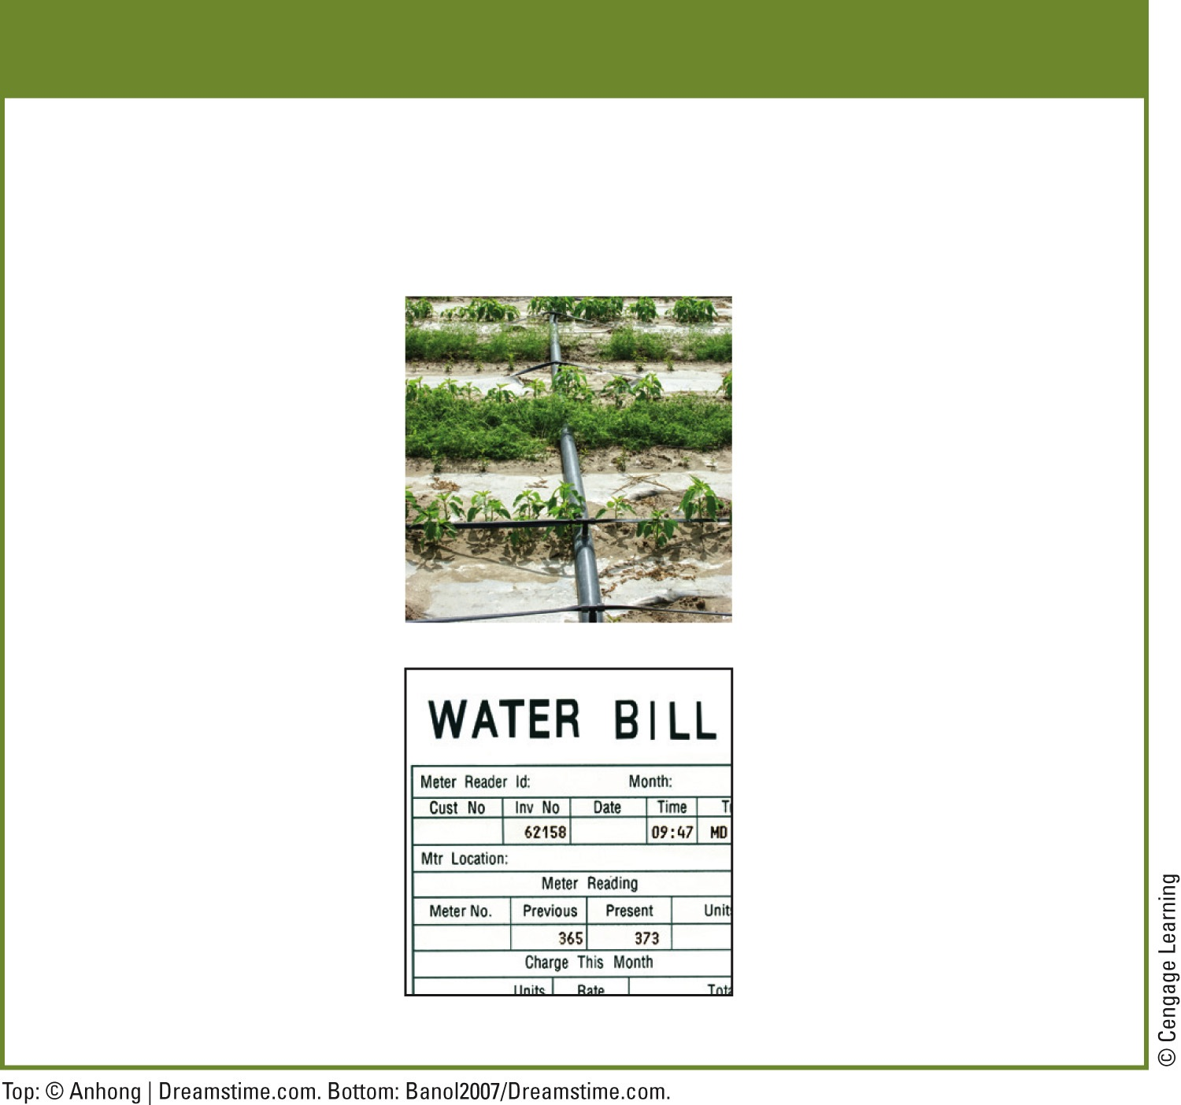
Solutions
Groundwater Depletion
Prevention
Control
Use water more efficiently
Raise price of water to discourage waste
Subsidize water conservation
Tax water pumped from wells near surface waters
Limit number of wells
Build rain gardens in urban areas
Stop growing water-intensive crops in dry areas
Use permeable paving material on streets, sidewalks, and driveways
Fig. 13-16, p. 329
Notes:
Figure 13-16: There are a number of ways to prevent or slow groundwater depletion by using freshwater more sustainably. Questions: Which two of these solutions do you think are the most important? Why?

Slide 29
Deep Aquifers Might Be Tapped
May contain enough water to provide for billions of people for centuries
Major concerns
  Nonrenewable
  Little is known about the geological and ecological impacts of pumping deep aquifers
  Some flow beneath more than one country
  Costs of tapping are unknown and could be high

Slide 30
13-3 Can Surface Water Resources Be Expanded?
Large dam-and-reservoir systems have greatly expanded water supplies in some areas, but have also disrupted ecosystems and displaced people

Slide 31
Use of Large Dams Provides Benefits and Creates Problems
Main goal of a dam and reservoir system
  Capture and store runoff
  Release runoff as needed to control:
    Floods
    Generate electricity
    Supply irrigation water
    Recreation (reservoirs)

Slide 32
Use of Large Dams Provides Benefits and Creates Problems (cont’d.)
Advantages
  Increase the reliable runoff available
  Reduce flooding
  Grow crops in arid regions

Slide 33
Use of Large Dams Provides Benefits and Creates Problems (cont’d.)
Disadvantages
  Displacement of people
  Flooded regions
  Impaired ecological services of rivers
  Loss of plant and animal species
  Fill up with sediment
  Can cause other streams and lakes to dry up

Slide 34
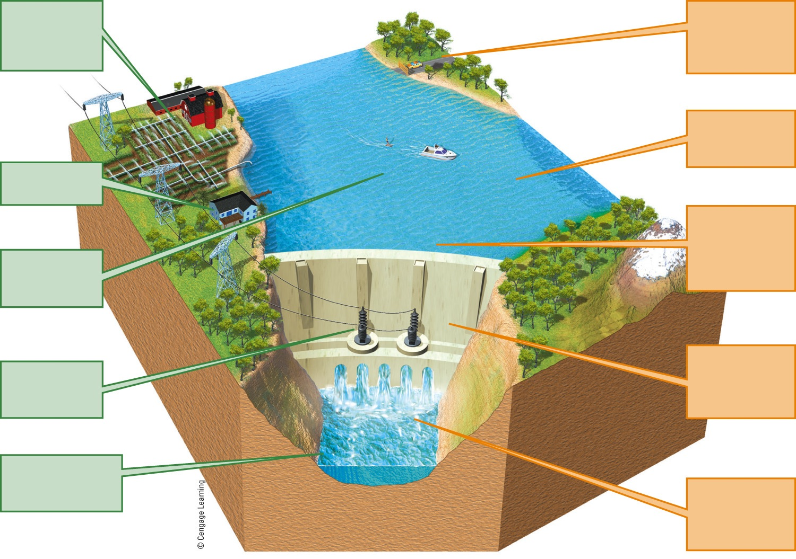
Provides irrigation water above and below dam
Flooded land destroys forests or cropland and displaces people
Large losses of water through evaporation
Provides water for drinking
Deprives downstream cropland and estuaries of nutrient-rich silt
Reservoir useful for recreation and fishing
Risk of failure and devastating downstream ﬂooding
Can produce cheap electricity (hydropower)
Reduces down-stream flooding of cities and farms
Disrupts migration and spawning of some fish
Fig. 13-17a, p. 330
Notes:
Figure 13.17 Trade-offs: Use of large dams and reservoirs has its advantages (green) and disadvantages (orange) (Concept 13-3). Questions: Which single advantage and which single disadvantage do you think are the most important? Why?

Slide 35
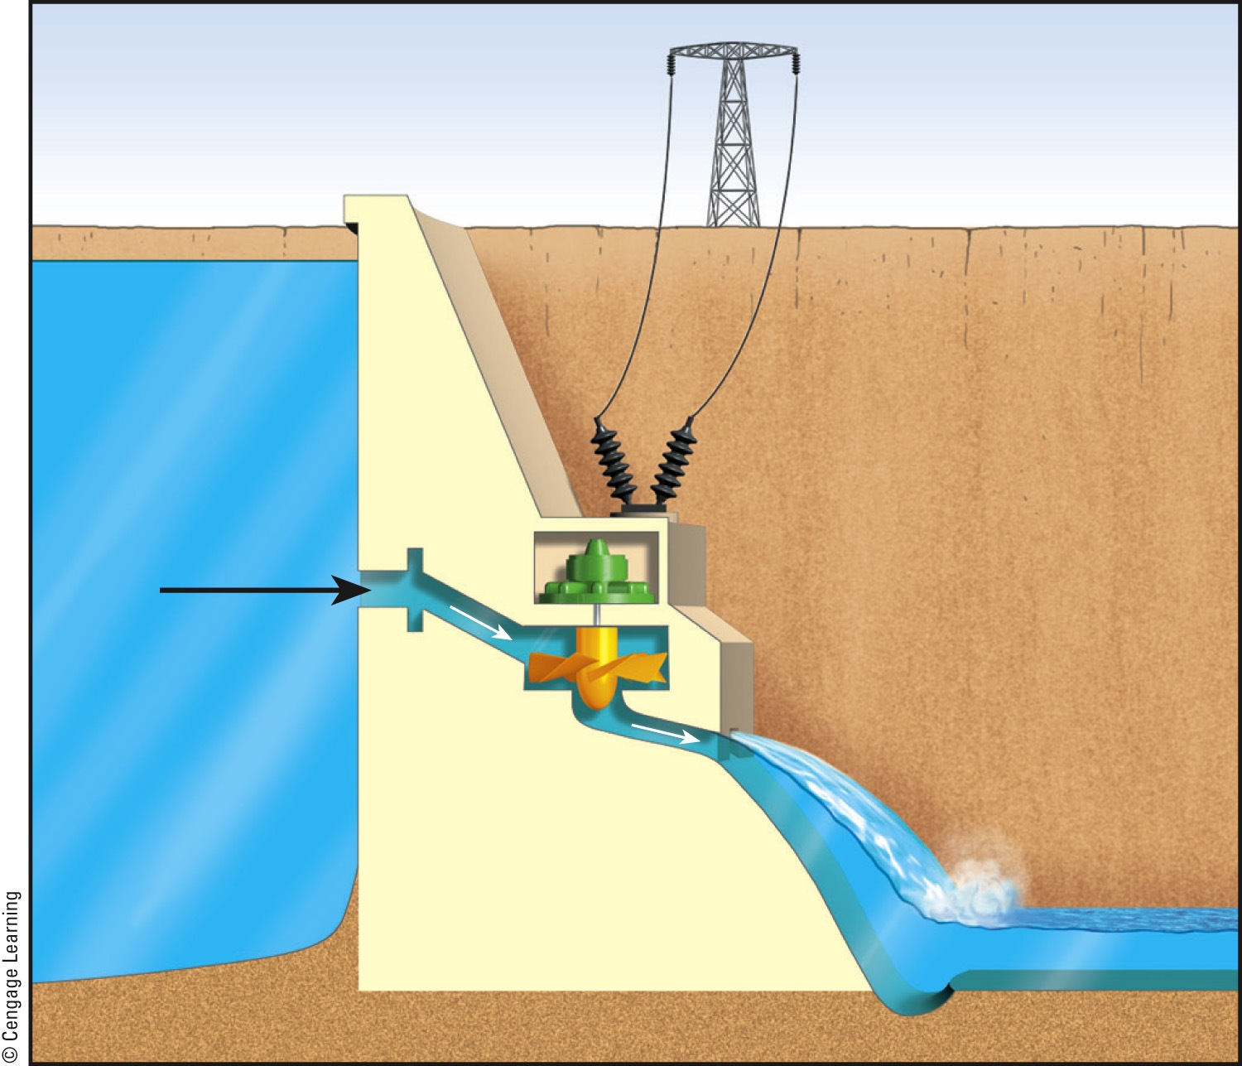
Powerlines
Reservoir
Dam
Powerhouse
Intake
Turbine
Fig. 13-17b, p. 330
Notes:
Figure 13.17 Trade-offs: Use of large dams and reservoirs has its advantages (green) and disadvantages (orange) (Concept 13-3). Questions: Which single advantage and which single disadvantage do you think are the most important? Why?

Slide 36
How Dams Can Kill an Estuary
Only small amount of Colorado River water reaches Gulf of California
  Threatens aquatic species in river and species that live in the estuary
Current rate of river withdrawal is not sustainable
Much water used for agriculture that is inefficient with water use

Slide 37
How Dams Can Kill an Estuary (cont’d.)
Reservoirs
  Leak water into ground below
  Lose much water through evaporation
  Fill up with silt load of river, depriving delta
  Could eventually lose ability to store water and create electricity
States must conserve water, control population, and slow urban development

Slide 38
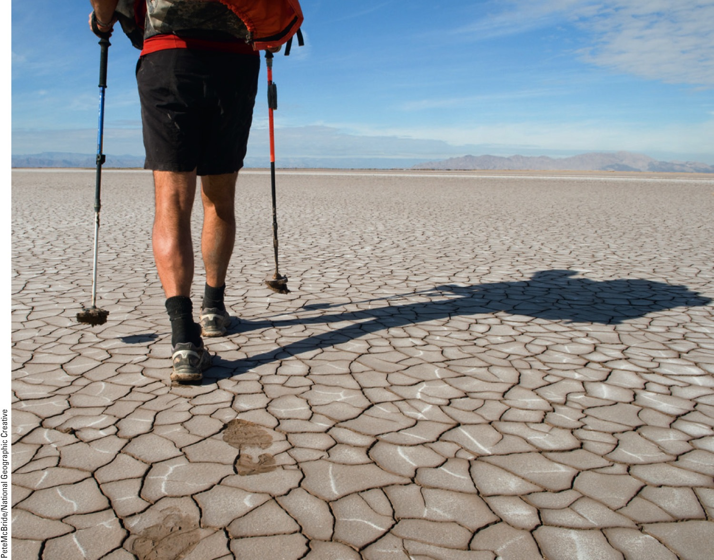
Fig. 13-18, p. 331
Notes:
Figure 13-18: The Colorado River delta once contained a rich variety of forests, wetlands, and wildlife. Now it is covered mostly by mud flats and desert.

Slide 39
13-4 Can Water Transfers Be Used to Expand Water Supplies?
Transferring water from one place to another has greatly increased water supplies in some areas, but has also disrupted ecosystems

Slide 40
Water Transfers Can Be Inefficient and Environmentally Harmful
China
  South-North Water Diversion Project
    Divert six trillion gallons of water
California central valley
  Aqueducts
Water loss through evaporation
Ecosystem degradation

Slide 41
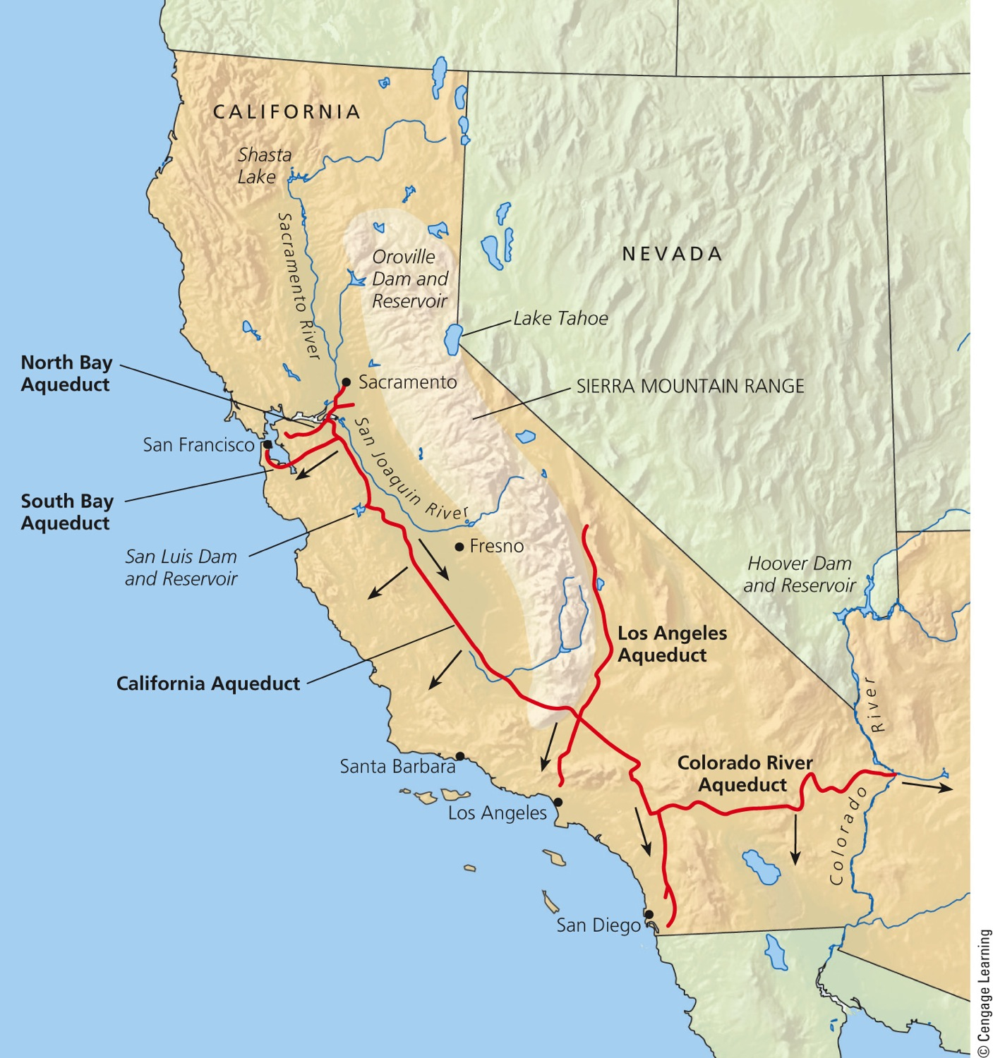
Fig. 13-19a, p. 332
Notes:
Figure 13.19 The California State Water Project transfers huge volumes of freshwater from one watershed to another. The arrows on the map show the general direction of water flow. The photo shows one of the aqueducts carrying water within the system. Questions: What effects might this system have on the areas from which the water is taken?

Slide 42
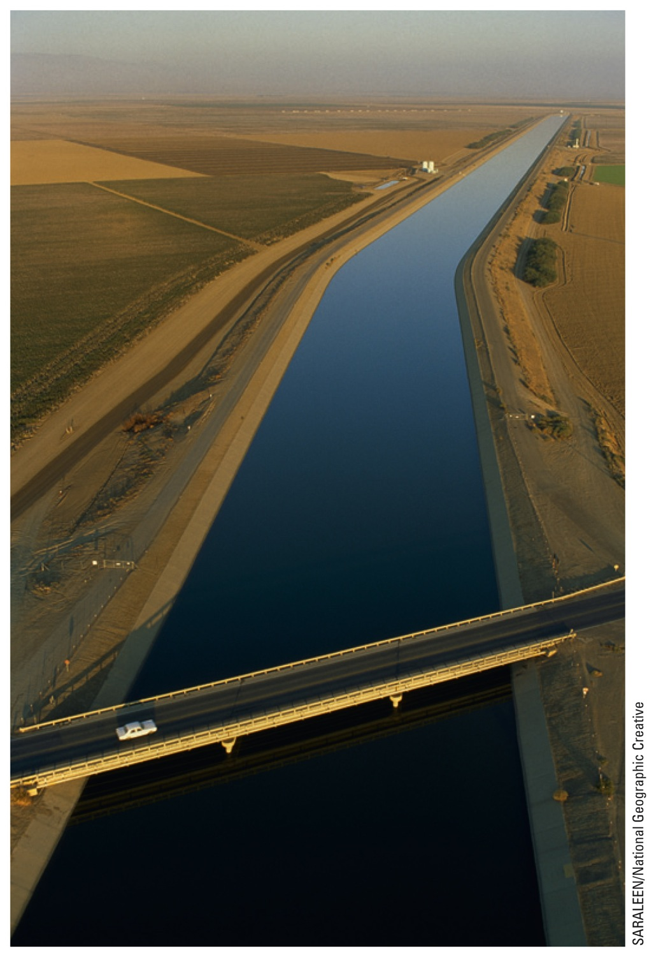
Fig. 13-19b, p. 332
Notes:
Figure 13.19 The California State Water Project transfers huge volumes of freshwater from one watershed to another. The arrows on the map show the general direction of water flow. The photo shows one of the aqueducts carrying water within the system. Questions: What effects might this system have on the areas from which the water is taken?

Slide 43
Case Study: The Aral Sea Disaster
Large-scale water transfers in dry central Asia have led to:
  Wetland destruction
    Desertification
  Greatly increased salinity
  Fish extinctions and decline of fishing

Slide 44
Case Study: The Aral Sea Disaster (cont’d.)
  Wind-blown salt
    Depositing on glaciers in the Himalayas
  Altered local climate
    Hot dry summers; cold winters
Restoration efforts
  Cooperation of neighboring countries
  More efficient irrigation
  Dike construction to raise lake level

Slide 45
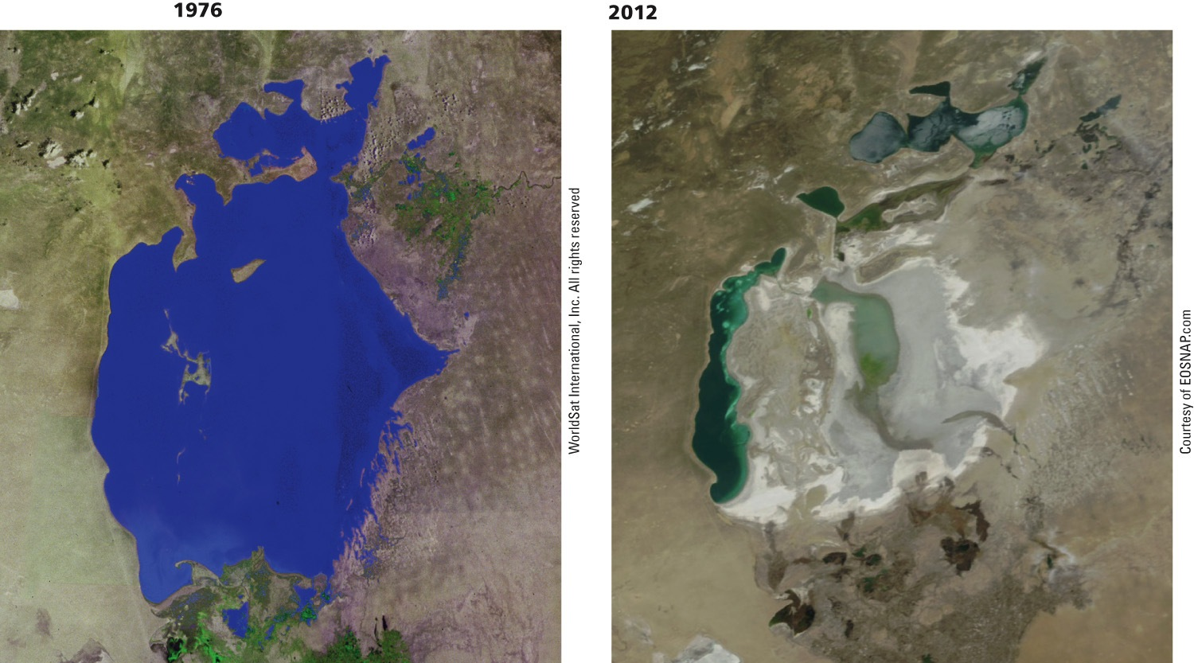
Fig. 13-20, p. 333
Notes:
Figure 13-20: Natural capital degradation. The Aral Sea, straddling the borders of Kazakhstan and Uzbekistan, was one of the world’s largest saline lakes. These satellite photos show the sea in 1976 (left) and in 2012 (right). Question: What do you think should be done to help prevent further shrinkage of the Aral Sea?

Slide 46
13-5 Is Desalination a Useful Way to Expand Water Supplies?
We can convert salty ocean water to freshwater, but the cost is high, and the resulting salty brine must be disposed of without harming aquatic or terrestrial ecosystems

Slide 47
Removing Salt from Seawater Is Costly and Has Harmful Effects
Desalination
  Removing dissolved salts
  Distillation – evaporate water, leaving salts behind
  Reverse osmosis, microfiltration – use high pressure to remove salts
More than 15,000 plants in 125 countries

Slide 48
Removing Salt from Seawater Is Costly and Has Harmful Effects (cont’d.)
Problems
  High cost and energy footprint
  Keeps down algal growth and kills many marine organisms
  Large quantity of brine wastes

Slide 49
13-6 How Can We Use Freshwater More Sustainably?
We can use freshwater more sustainably by:
  Cutting water waste
  Raising water prices
  Slowing population growth
  Protecting aquifers, forests, and other ecosystems that store and release freshwater

Slide 50
Reducing Freshwater Losses Can Provide Many Benefits
One-half to two-thirds of water is wasted
The cost of water to users is low
Subsidies mask the true cost of water
Raising prices will hurt lower-income farmers and city dwellers
  Solution: establish lifeline rates

Slide 51
We Can Improve Efficiency in Irrigation
Flood irrigation
  Wasteful
Center pivot, low pressure sprinkler
Low-energy; precision application sprinklers
Drip or trickle irrigation, microirrigation
  Costly
  Less water waste

Slide 52
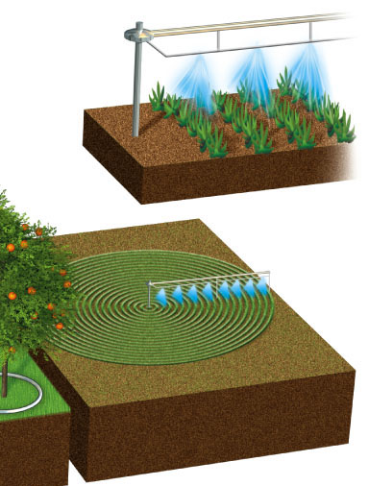
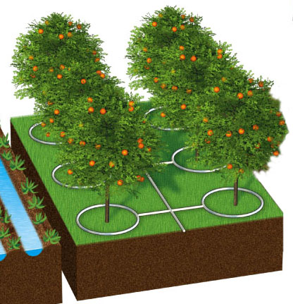
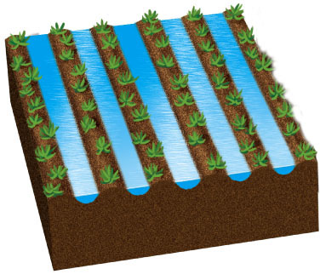
Center pivot
(efficiency 80% with low-pressure sprinkler and 90–95% with LEPA sprinkler)
Drip irrigation
(efficiency 90–95%)
Gravity flow
(efficiency 60% and 80% with surge valves)
Above- or below-ground pipes or tubes deliver water to individual plant roots.
Water usually pumped from underground and sprayed from mobile boom with sprinklers.
Water usually comes from an aqueduct system or a nearby river.
Stepped Art
Fig. 13-22, p. 337
Notes:
Figure 13-22: Traditional irrigation methods rely on gravity and flowing water (left). Newer systems such as center-pivot, low-pressure sprinkler irrigation (right) and drip irrigation (center) are far more efficient.

Slide 53
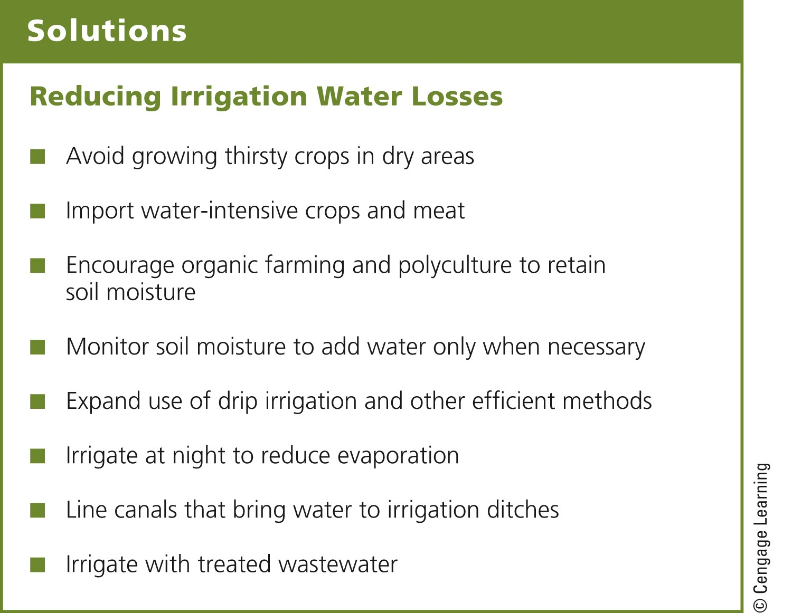
Fig. 13-25, p. 338
Notes:
Figure 13-25: There are a number of ways to reduce freshwater losses in irrigation. Questions: Which two of these solutions do you think are the best ones? Why?

Slide 54
Poor Farmers Conserve Water Using Low-Tech Methods
Human-powered treadle pumps
Harvest and store rainwater
Use tensiometers
  Measure soil moisture
Use polyculture to create canopy vegetation
  Reduces evaporation

Slide 55
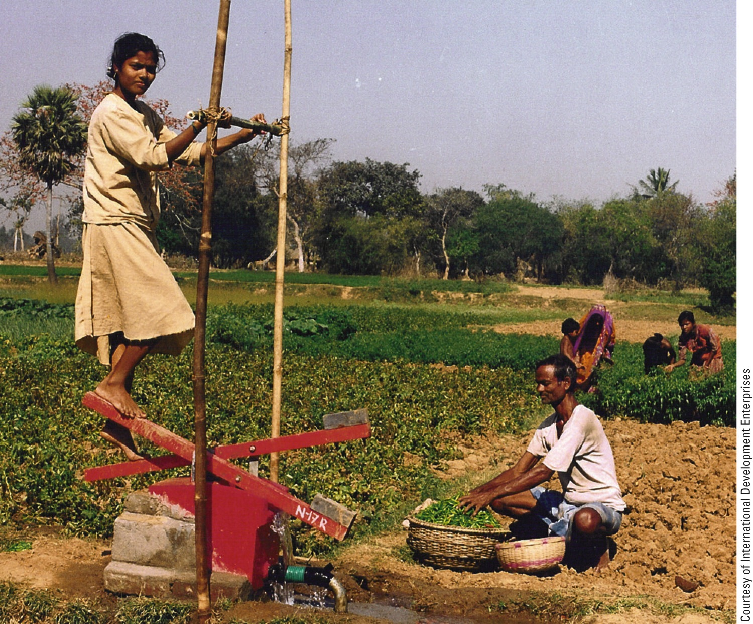
Fig. 13-24, p. 338
Notes:
Figure 13-24: Solutions. In areas of Bangladesh and India, where water tables are high, many small-scale farmers use treadle pumps to supply irrigation water to their fields.

Slide 56
We Can Cut Freshwater Losses in Industry and Homes
Recycle water in industry
Fix leaks in the plumbing systems
Use water-thrifty landscaping: xeriscaping
Use gray water
Pay-as-you-go water use

Slide 57
Solutions: Reducing Water Waste
Fig. 13-27, p. 340
Notes:
Figure 13-27: There are a number of ways to reduce freshwater losses in industries, homes, and businesses (Concept 13-6). Questions: Which three of these solutions do you think are the best ones? Why?

Slide 58
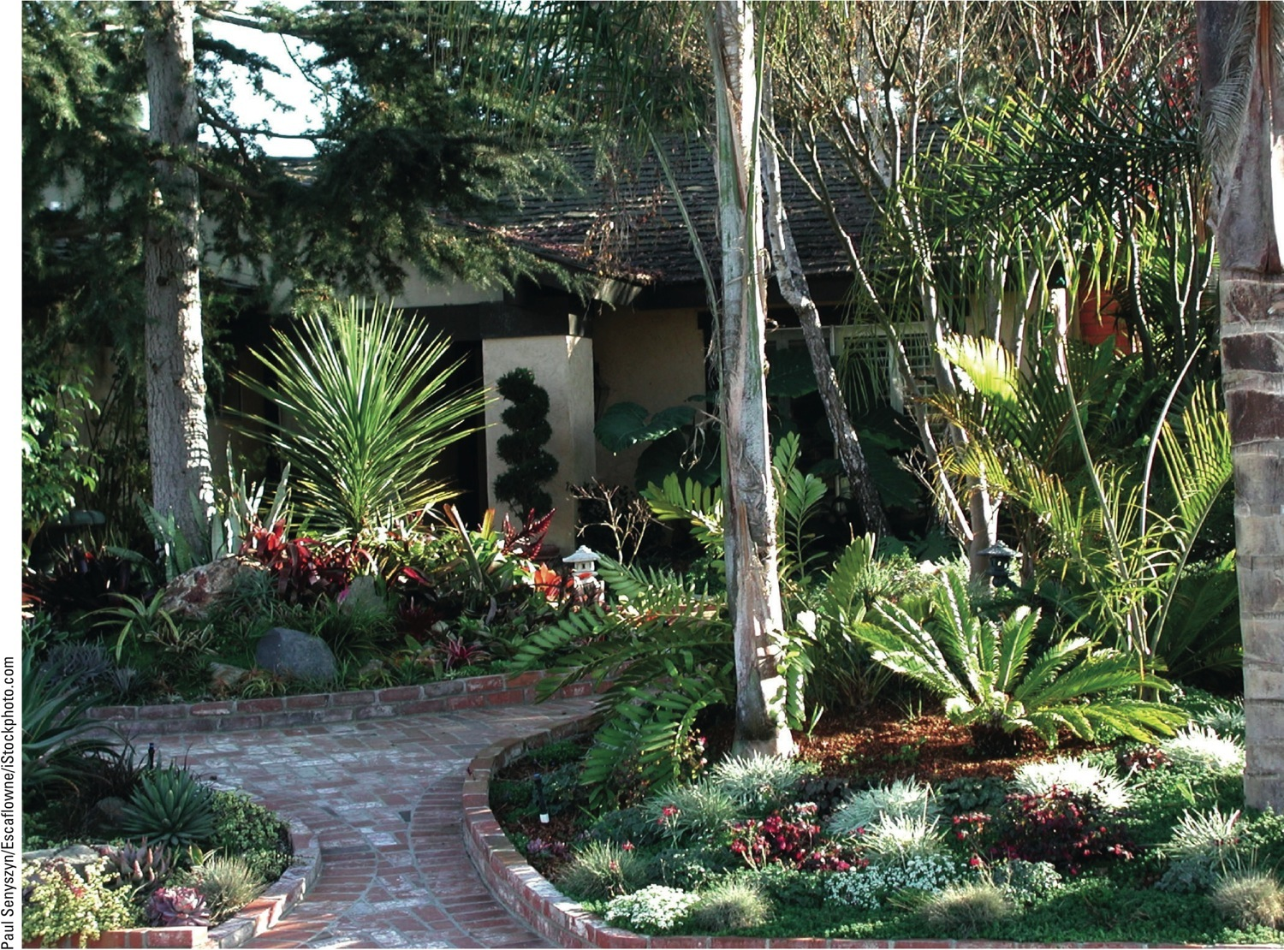
Fig. 13-26, p. 339
Notes:
Figure 13-26: This yard in Encinitas, a city in a dry area of southern California (USA), uses a mix of plants that are native to the arid environment and require little watering.

Slide 59
We Can Use Less Water to Remove Wastes
Use human sewage to create nutrient-rich sludge to apply to croplands
Use waterless composting toilets

Slide 60
We Can Each Help Out in Using Water More Sustainably
Protect water supplies
Apply strategies at local, regional, national, and international levels
Also apply strategies at a personal level

Slide 61
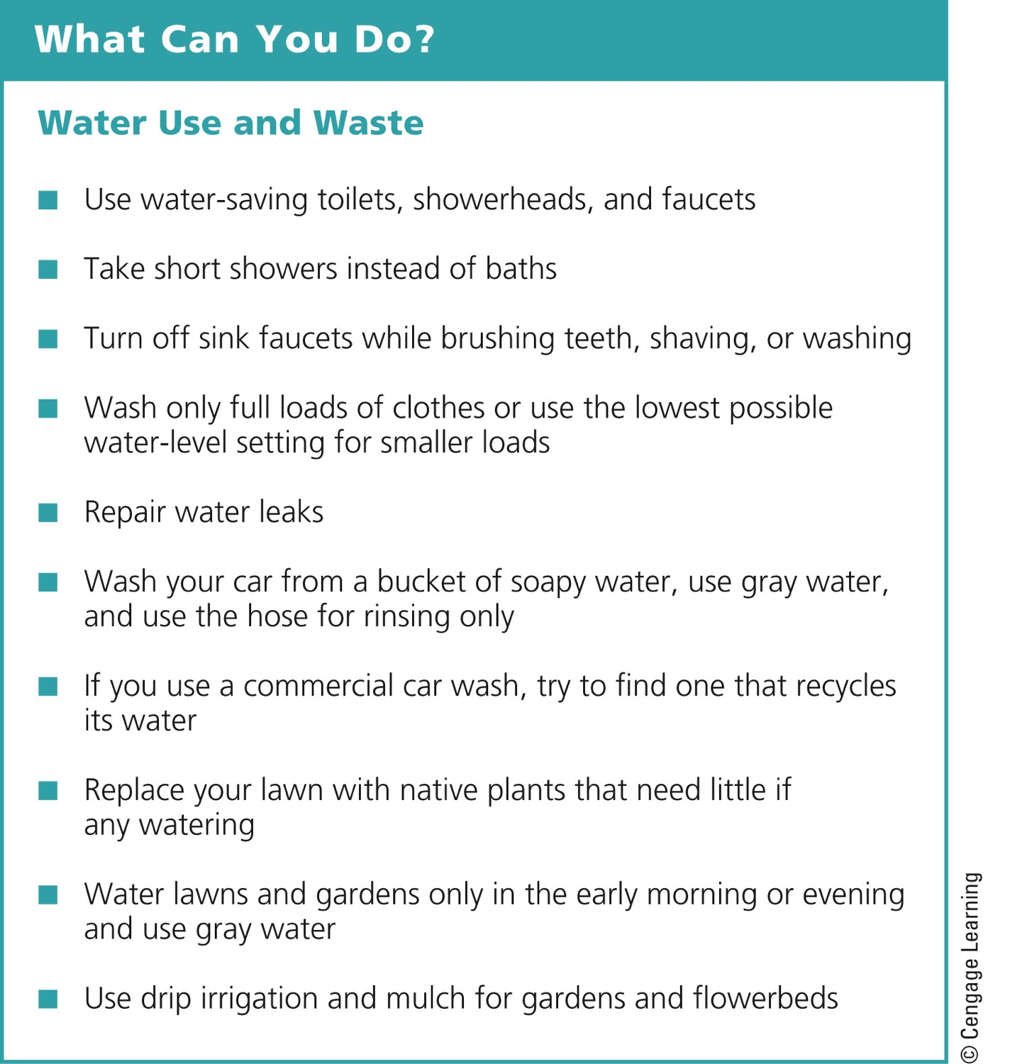
Fig. 13-28, p. 341
Notes:
Figure 13-28: Individuals matter: You can reduce your use and waste of freshwater. Questions: Which of these steps have you taken? Which would you like to take?

Slide 62
13-7 How Can We Reduce the Threat of Flooding?
We can lessen the threat of flooding by:
  Protecting more wetlands and natural vegetation in watersheds
  Not building in areas subject to frequent flooding

Slide 63
Some Areas Get Too Much Water from Flooding
Flood plains
  Highly productive wetlands
  Provide natural flood and erosion control
  Maintain high water quality
  Recharge groundwater
Benefits of floodplains
  Fertile soils; nearby rivers for use and recreation
  Flatlands for urbanization and farming

Slide 64
Some Areas Get Too Much Water from Flooding (cont’d.)
Human activities make floods worse
  Levees can break or be overtopped
  Paving and development increase runoff
  Removal of water-absorbing vegetation
  Draining wetlands and building on them
  Rising sea levels from global warming means more coastal flooding

Slide 65
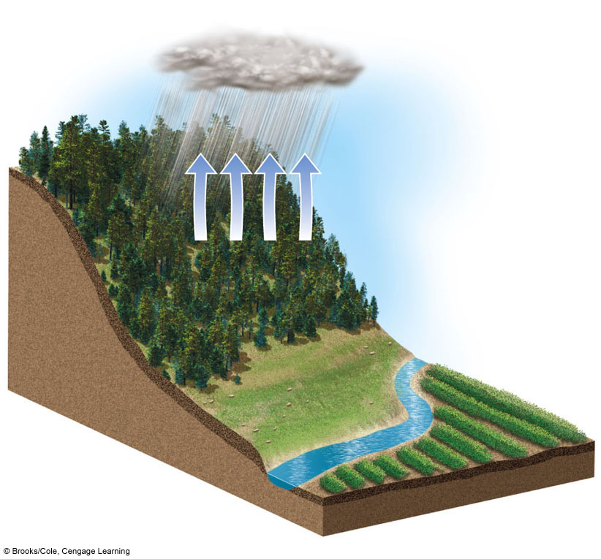
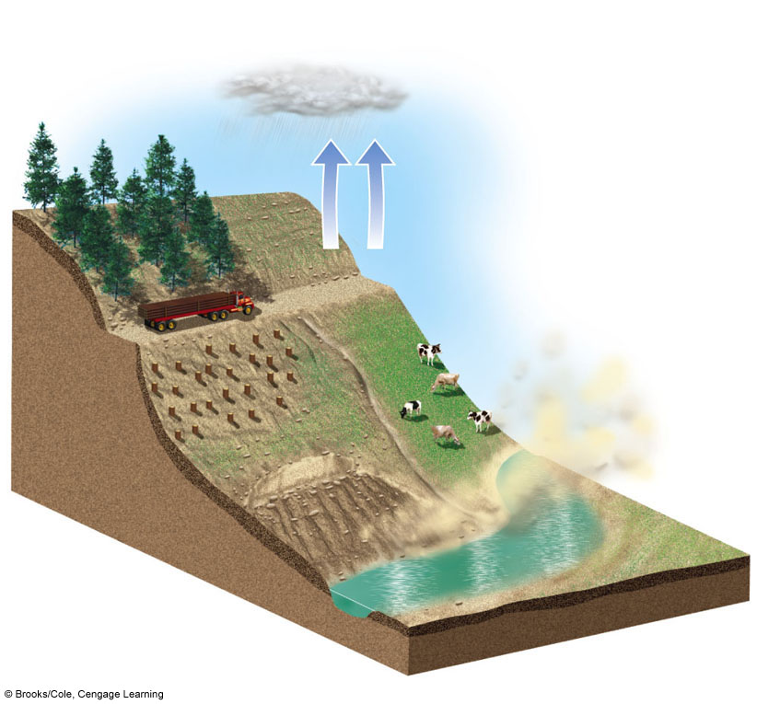
Tree plantation
Diverse ecological habitat
Evapotranspiration
Roads destabilize hillsides
Evapotranspiration decreases
Trees reduce soil erosion from heavy rain and wind
Overgrazing accelerates soil erosion by water and wind
Winds remove fragile topsoil
Agricultural land
Agricultural land is flooded and silted up
Tree roots stabilize soil
Gullies and landslides
Heavy rain erodes topsoil
Vegetation releases water slowly and reduces flooding
Silt from erosion fills rivers and reservoirs
Rapid runoff causes flooding
Forested Hillside
After Deforestation
Stepped Art
Fig. 13-29, p. 343
Notes:
Figure 13-29: Natural capital degradation: A hillside before and after deforestation. Question: How might a drought in this area make these effects even worse?

Slide 66
Case Study: Living Dangerously on Floodplains in Bangladesh
Dense population on coastal floodplain
Moderate floods maintain fertile soil
Increased frequency of large floods
Destruction of coastal wetlands
  Mangrove forests cleared
  Increase damages from storms

Slide 67
We Can Reduce Flood Risks
Rely more on nature’s systems
  Wetlands
  Natural vegetation in watersheds
Rely less on engineering devices
  Dams
  Levees
  Channelized streams

Slide 68
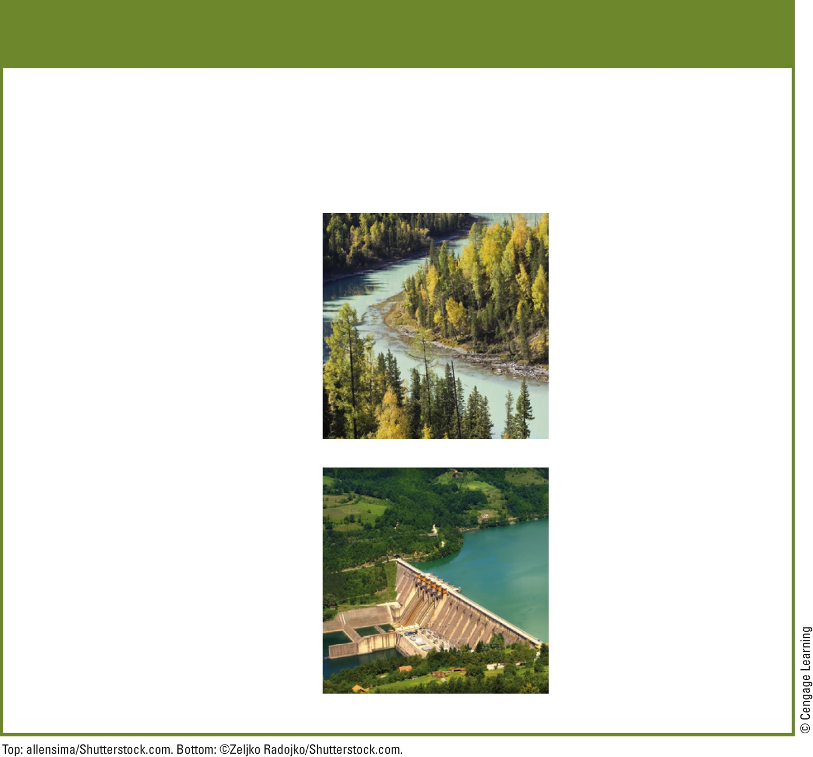
Solutions
Reducing Flood Damage
Prevention
Control
Preserve forests on watersheds
Straighten and deepen streams (channelization)
Preserve and restore wetlands in floodplains
Build levees or floodwalls along streams
Tax development on floodplains
Increase use of floodplains for sustainable agriculture and forestry
Build dams
Fig. 13-30, p. 344
Notes:
Figure 13-30: Methods for reducing the harmful effects of flooding (Concept 13-7). Questions: Which two of these solutions do you think are the best ones? Why?

Slide 69
Three Big Ideas
One of the major global environmental problems is the growing shortage of freshwater in many parts of the world
We can expand water supplies in water-short areas
  Most important to reduce overall water use and use water much more efficiently

Slide 70
Three Big Ideas (cont’d.)
We can use water more sustainably
  Cut water losses
  Raise water prices
  Protect aquifers, forests, and other ecosystems that store and release water

Slide 71
Tying It All Together: The Colorado River and Sustainability
Large dams and diversion projects help with:
  Electricity, food, drinking water, and flood control
Large dams degrade aquatic natural capital
We need to:
  Rely on solar energy for desalination
  Recycle more water

